Slide 1
Generative AI and Large Language Models(LLMs)
Dr. Shivanna K
Associate Professor
Pratheeksha S Mogaveera 4SF21CS113

Slide 2
Table of Content
Si. No | Particulars
1 | Abstract
2 | Introduction
3 | Problem Formulation
4 | Methodology and Implementation
5 | Outcome of Seminar
6 | Conclusion
 | References
 | book chapter updates

Slide 3
Abstract
Generative artificial intelligence (AI) is revolutionizing machine learning by enabling systems to autonomously generate human-like text, images, code, and more. Central to this transformation are large language models (LLMs) such as GPT, PaLM, and LLaMA, which are trained on massive datasets using deep neural networks, particularly transformer architectures. These models demonstrate exceptional capabilities in natural language processing, image synthesis, and automated programming, significantly enhancing productivity and creativity across industries. This overview explores foundational techniques like self-supervised learning and fine-tuning, which contribute to the adaptability and performance of generative AI across diverse tasks. While the applications are vast—from chatbots and AI art to coding tools—rapid deployment also introduces challenges such as algorithmic bias, misinformation, privacy concerns, and lack of transparency. As generative AI continues to evolve and integrate into everyday life, it is crucial to balance innovation with ethical responsibility and thoughtful governance.

Slide 4
Introduction
Artificial Intelligence (AI) has undergone remarkable transformation over the past few decades, evolving from rule-based symbolic approaches to data-intensive machine learning systems. Among the most impactful developments is the rise of Generative AI—a class of models capable of creating content such as text, images, audio, and code with human-like fluency. This shift marks a significant turning point, enabling machines not only to interpret and analyze data but also to generate contextually meaningful and creative outputs.

Slide 5
Problem Statement
Despite the impressive strides in generative AI and large language models (LLMs), numerous unresolved issues challenge their development, deployment, and societal integration. The field lacks a structured synthesis of the core methodologies and their implications, limiting accessibility for both newcomers and domain experts. At the same time, concerns around explainability, ethical risks, computational demands, and equitable access remain at the forefront, demanding deeper investigation and clearer guidance.

Slide 6
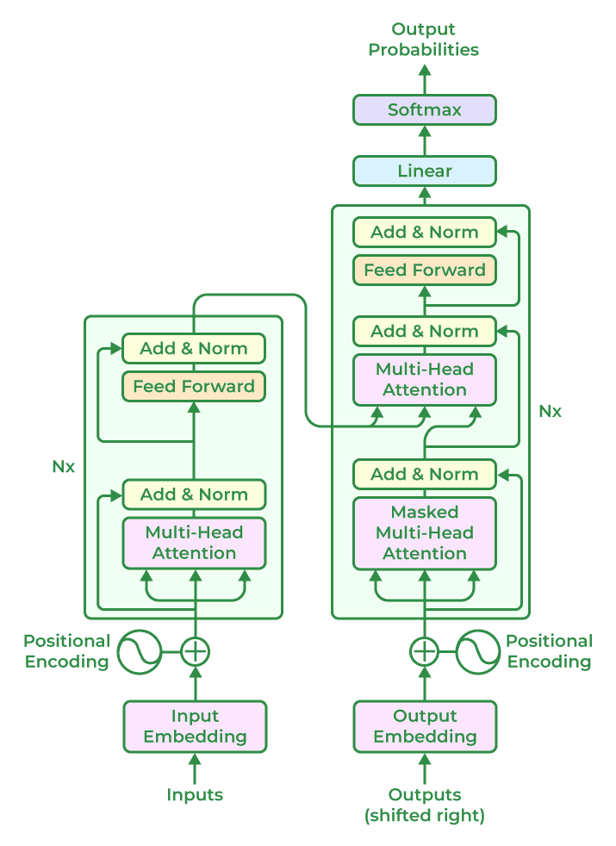
Methodology and Implementation

Slide 7
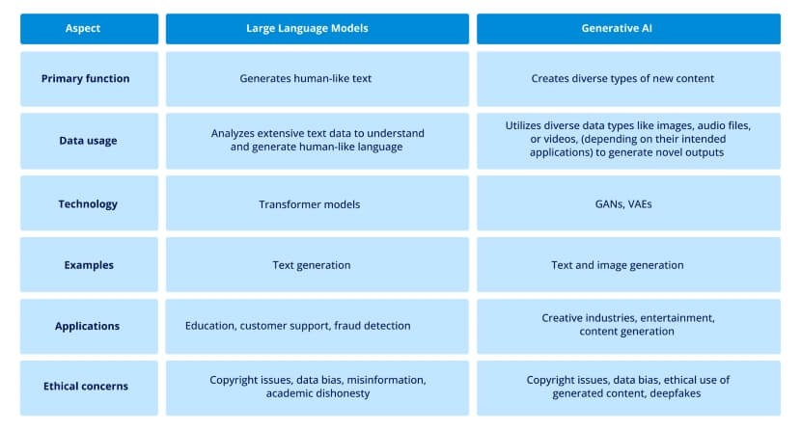
Difference between Generative AI and LLMs

Slide 8
Training Paradigms
Unsupervised Pretraining: Models are first trained on large unlabeled text datasets using objectives like next-token prediction (autoregressive) or masked language modeling (e.g.,BERT). This phase captures a general understanding of syntax, semantics, and world knowledge.
Supervised Fine-Tuning: After pretraining, models are adapted to specific tasks (e.g., summarization, translation, QA) using labeled datasets. This improves task-specific performance and alignment with real-world inputs.

Slide 9
Training Paradigms
Reinforcement Learning from Human Feedback (RLHF): Pioneered by models like InstructGPT and GPT-4, this technique involves:
1. Collecting ranked output comparisons from humans,
2. Training a reward model to mimic these preferences,
3.Using reinforcement learning (typically Proximal Policy Optimization) to optimize the model for helpfulness, harmlessness, and factual accuracy.

Slide 10
Model Scaling Laws
The performance of LLMs improves predictably with increased model size, dataset size, and compute budget, as shown by Kaplan et al. (2020). These scaling laws empirically demonstrate that larger models:
– Generalize better,
– Require fewer examples for adaptation,
– Can transfer across tasks with minimal fine-tuning.

Slide 11
Inference & Prompt Engineering
Unlike traditional models that require retraining, LLMs can perform many tasks at inference time using well-crafted prompts. This ability is attributed to in-context learning, where the model leverages examples provided within the input to generate coherent and relevant outputs.
Key prompting strategies include:
– Zero-shot prompting: Asking the model to perform a task without examples (e.g., “Translate this to French”).
– Few-shot prompting: Providing a few input-output pairs to demonstrate the task.
– Chain-of-thought prompting: Encouraging reasoning by including intermediate steps or explanations (e.g., for math or logic tasks).

Slide 12
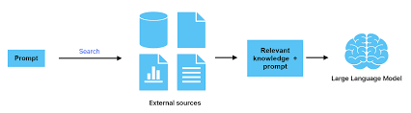
Architecture of Prompt Engineering

Slide 13
Techniques in Image and Multimodal Generation
Generative AI has expanded beyond text to include images, audio, video, and 3D content using several advanced model families:
– Diffusion Models: These models (e.g., Stable Diffusion, Imagen) generate high-fidelity images by iteratively denoising a random noise vector conditioned on text. They achieve state-of-the-art results in realism and controllability.
– GANs (Generative Adversarial Networks): Earlier image generation methods where a generator and discriminator compete to produce realistic outputs. While less dominant now, GANs are still used in stylized and domain-specific applications.
– CLIP-guided Generation: OpenAI’s CLIP (Contrastive Language–Image Pretraining) links text and image embeddings in a shared space. It enables guided generation by maximizing similarity between generated visuals and text prompts.
– Multimodal Transformers: Models like Gemini and Kosmos-1 unify vision and language processing into a single transformer pipeline, enabling tasks like image captioning, visual question answering, and text-conditioned video synthesis.

Slide 14
Applications of Generative AI and Large Language Models
Text Generation, Summarization, and Translation
- Text generation: Models like GPT-4, Claude, and PaLM
- Summarization: Tools such as ChatGPT and Notion AI
- Translation: Multilingual models (e.g., Google’s mT5, Meta’s No Language Left Behind)
2. Image Creation and Editing
– Image synthesis: Tools like DALL·E 3, Midjourney, and Stable Diffusion
– Image editing: Models such as Adobe Firefly and RunwayML

Slide 15
Applications of Generative AI and Large Language Models
3. Code Generation and Software Development
- Autocompletion and generation: Tools like GitHub Copilot and Amazon CodeWhisperer
- Debugging and explanation: LLMs help detect bugs, explain code logic, and suggest refactorings,
- Low-code development: By bridging natural language and code, generative AI enables non-programmers to develop applications through conversational interfaces.
4. Education and Accessibility
– Tutoring and learning aids: AI tutors like Khanmigo or ChatGPT
– Assistive technologies: LLMs and speech-to-text tools help users with dyslexia

Slide 16
Applications of Generative AI and Large Language Models
3. Scientific Research, Healthcare, and Industry
- Drug discovery: Models like AlphaFold and generative chemistry models assist in molecular design, protein folding prediction, and novel compound generation.
- Financial modeling: LLMs can parse reports, extract insights, generate forecasts, and auto-mate compliance checks in finance and banking.
- Scientific research: Tools like Elicit and Galactica automate literature review, hypothesis generation, and experiment planning.

Slide 17
Challenges and Ethical Concerns
Data Bias and Fairness
Hallucination and Misinformation
Energy and Compute Costs
Intellectual Property and Content Ownership
Alignment and Safety Concerns

Slide 18
Future Scope
Model Efficiency
– Distillation: Compresses large models into smaller ones by transferring knowledge from a teacher model to a student model, retaining performance with reduced size.
– Quantization: Reduces memory usage and compute by representing model weights in lower-precision formats (e.g., INT8 instead of FP32).
Personalized Agents
- AI Tutors: Tailored educational support systems capable of understanding individual learning styles and providing adaptive guidance.
– Companion Bots: Empathetic conversational agents offering emotional support and daily companionship.

Slide 19
Outcome of Seminar
Comprehensive Insight into Generative AI: Gained a solid understanding of transformer-based architectures and major models like GPT-4, PaLM, LLaMA, and DALL·E, including their training and capabilities.
Advanced Techniques & Applications: Explored cutting-edge methods such as RLHF, diffusion models, and prompt engineering, along with applications in education, healthcare, design, coding, and research.
Ethical & Societal Considerations: Reflected on key challenges like data bias, misinformation, environmental impact, and AI alignment, emphasizing the importance of responsible development.
Future Outlook: Discussed upcoming trends including model efficiency, personalization, responsible governance, and the impact of open-source contributions in shaping the future of generative AI.

Slide 20
Conclusion
Generative AI and large language models (LLMs) are revolutionizing industries by enabling text generation, image creation, and code development, driving innovation across domains. While their capabilities offer immense potential, ethical challenges such as data bias, misinformation, and environmental impact must be addressed. The future of AI depends on responsible development through interdisciplinary collaboration, transparency, and alignment with human values to ensure these technologies amplify human potential while safeguarding societal well-being.

Slide 21
References
[1] S. Chowdhery et al., ”PaLM: Scaling Language Modeling with Pathways,” arXivpreprint arXiv:2204.02311, 2022.
[2] H. Touvron et al., ”LLaMA: Open and Efficient Foundation Language Models,” arXivpreprint arXiv:2302.13971, 2023.
[3] H. Touvron et al., ”LLaMA 2: Open Foundation and Fine-Tuned Chat Models,”arXiv preprint arXiv:2307.09288, 2023.
[4] OpenAI, ”GPT-4 Technical Report,” arXiv preprint arXiv:2303.08774, 2023.
[5] Google DeepMind, ”Gemini Technical Overview,” 2023.
[6] Anthropic, ”Constitutional AI: Harmlessness from AI Feedback,” arXiv preprintarXiv:2212.08073, 2022.
[7] Z. Zeng et al., ”GLM-130B: An Open Bilingual Pre-trained Model,” arXiv preprintarXiv:2210.02414, 2022.

Slide 22
Thank You

